Slide 1





FX-CHANGE
Presented by : fx-Change Founding Team

Slide 2






our team
Noah Sheldon
Eyup Aygun
Marcel G. Ionite

Slide 3
USER STORY
Emily is a consultant and forex investor who travels frequently.
She requires a tool for easy management and analysis of currency data.
With fx-Change, she:
- Converts expenses into different currencies effortlessly.
- Reviews historical exchange rates for precise expense reports.
- Stays informed on forex market trends with real-time news.
The app enhances her financial management during international travels.
It also improves her investment strategies with up-to-date information.

Slide 4

THE DRIVE BEHIND FX-CHANGE
Recognized the need for an accessible forex tool amidst complex platforms.
Observed that existing services were either too complex or insufficient.
Created fx-Change to provide swift, reliable currency conversions.
Incorporated features for accessing detailed historical data and current forex news.
Emphasized user-friendliness to make forex data straightforward and actionable.

Slide 5


MAIN FEATURES
1
Currency Exchanger
2
Historical Graphs
3
Forex News

Slide 6
HIGH LEVEL USE CASES
Designed for financial enthusiasts at any level.
Offers real-time currency conversion.
Provides historical exchange rate analysis.
Delivers the latest forex market news.

Slide 7
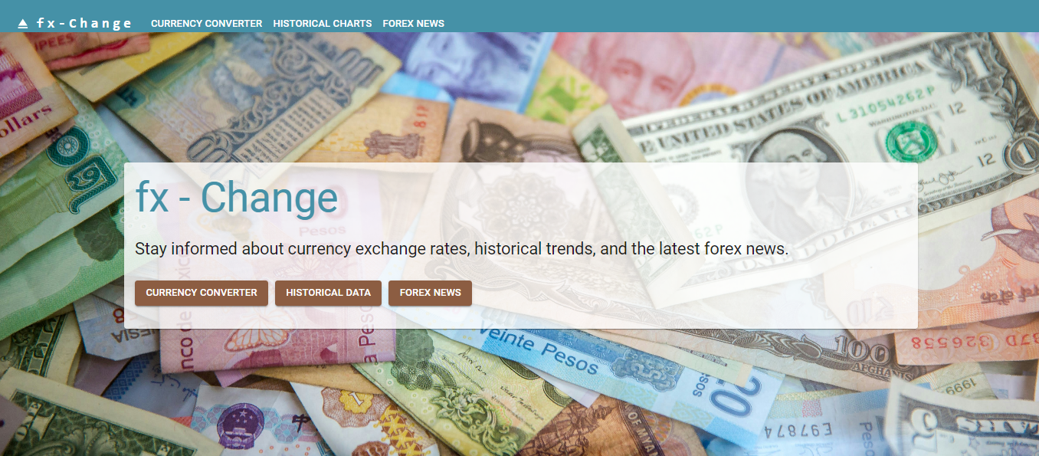
LANDING PAGE

Slide 8
DEVELOPMENT TIMELINE
fx-Change utilizes a modern technology stack for peak performance and user experience.
React is employed for efficient UI rendering.
Material-UI enhances the app with sleek design and interactive components.
Recharts powers dynamic data visualization and charting.
Bootstrap guarantees responsiveness on all devices.
Axios is crucial for fetching data from APIs.
Material-UI Table is used for sophisticated data presentation.
REACT
AXIOS
MATERIAL UI
MATERIAL UI TABLE
BOOTSTRAP
RECHARTS

Slide 9
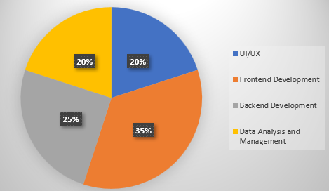
BREAKDOWN OF TASKS AND ROLES
Project Management Methodology: Agile
Allows for flexibility and iterative improvement.
Adapts quickly to changes and incorporates user feedback efficiently.
Task Distribution:
UI/UX Design (20% of effort)
Designing an intuitive and visually appealing interface with Material-UI.
Frontend Development (35% of effort)
Building the user interface with React and integrating interactive components.
Backend Development (25% of effort)
Server-side logic and data retrieval using Axios for API calls.
Data Analysis and Management (20% of effort)
Organizing and presenting data with Material-UI Table.

Slide 10
CHALLENGES
Real-time Data Integration: Selecting reliable financial data sources and managing API constraints.
User Interface Design: Balancing simplicity and functionality for diverse user needs.
Data Visualization: Making complex financial data accessible and understandable.

Slide 11
SUCCESSES
Seamless User Experience
Developed an intuitive interface welcomed by users of all expertise levels.
Enhanced user engagement through ease of use.
Effective Data Visualization
Provided clear, informative charts for exchange rates and market trends.
Supported user decision-making with valuable visual data insights.

Slide 12
PROJECT LINKS
https://fx-change.netlify.app/
Deployment link:
https://github.com/noah-sheldon/fxChange
GitHub Repository:
https://github.com/noah-sheldon/fxChange/blob/main/README.md
Readme Link:

Slide 13

DEMO

Slide 14
THANK YOU
Presented by : fx-Change

